Slide 1
Concrete/Shape Poems

Slide 2
What is a concrete poem?
It is sometimes called “shape poetry” because it looks like the topic of your poem.
There are 2 ways to make a shape poem
Outline poems
Drawing poems

Slide 3
Outline Poems

Slide 4
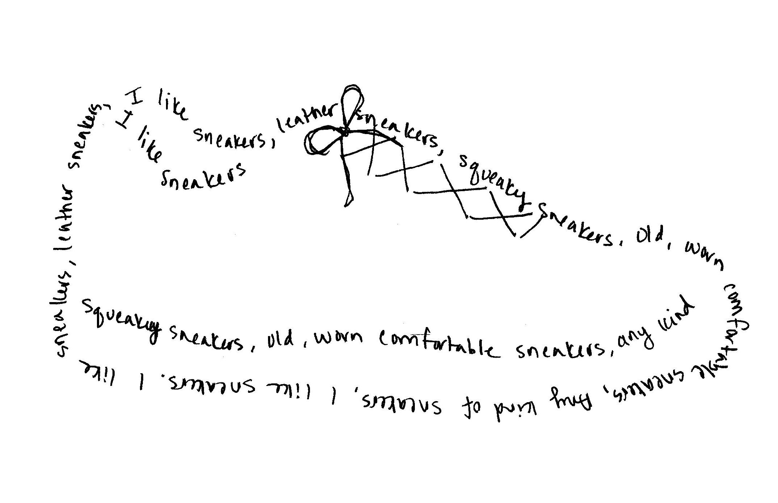
Outline Poems
Outline poems fill an outline shape that relates to the topic of the poem. Ex. Kite or love/heart.
1. Choose an object to be the subject for your poem like your favorite food or animal.
2. Lightly draw a simple outline of it’s shape on paper with pencil.
3. Write your poem normally on another paper.
4. Try to describe how the subject makes you feel.
5. Lightly write your poem into the shape. You may need to make a good copy so it fits nicely.
6. Then erase the outline and go over the words with pen or marker
6-12 lines is a good length.
IT DOESN’T HAVE TO RHYME!

Slide 5
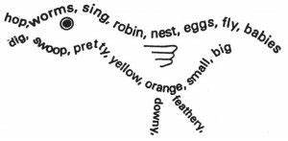
Drawing Poems

Slide 6
Drawing Poems
In this type of concrete poem, you use the lines of words to make the lines of a drawing.
As with the last poem, write your poem first on a regular paper, then decide how big your “shoe” or whatever object you use to write about is.
Copy your poem onto a new paper with the words making the shape of the object.

